Slide 1


Max Heap
Team SCV – Chu Jae Hun

Slide 2
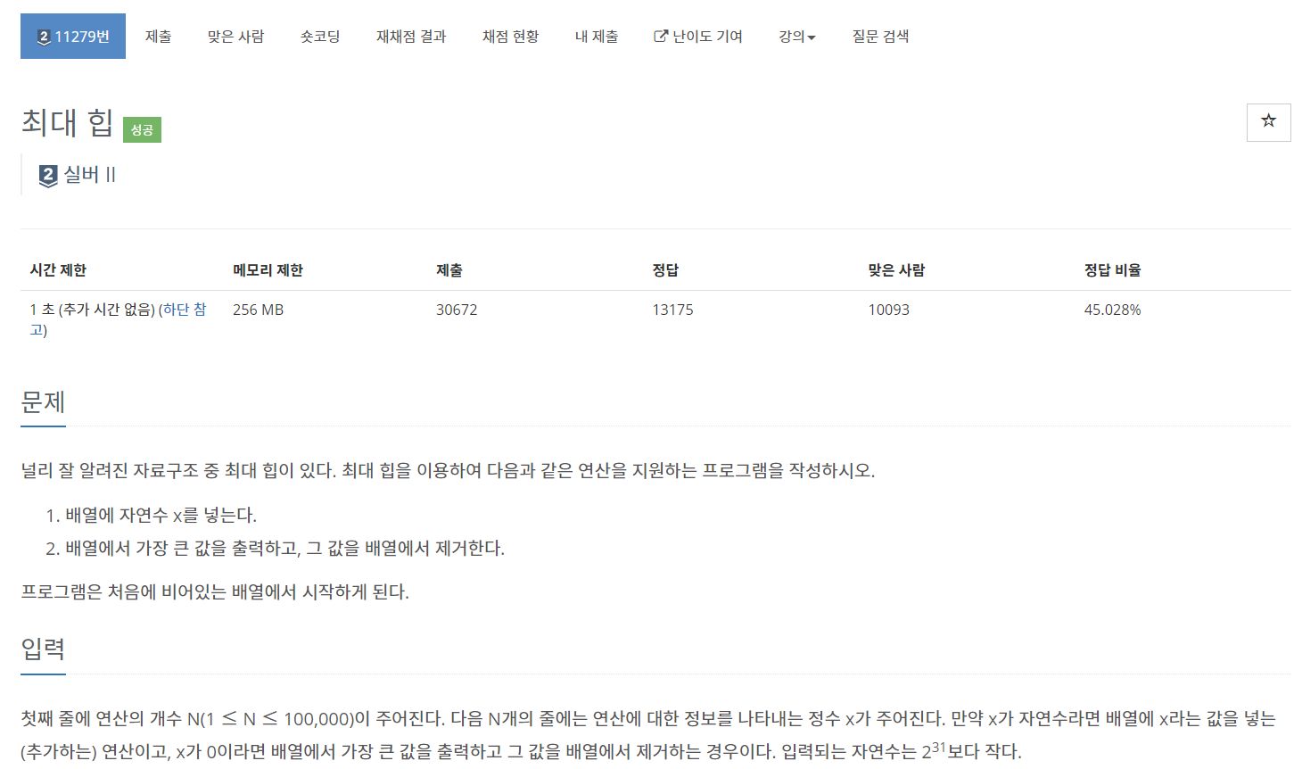
About Problem..
In/Output :
13 0 0 2 1 1 2 3 0 2 0 1 3 0 2 0 1 0 0 0 0 0

Slide 3
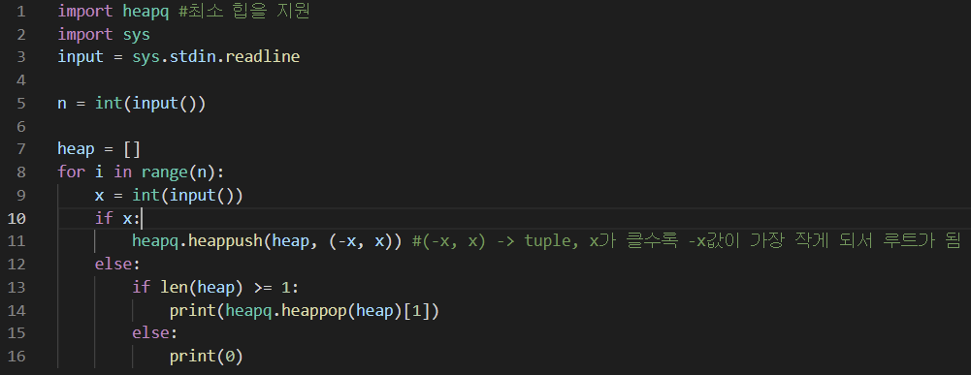
Procedure..

Slide 4
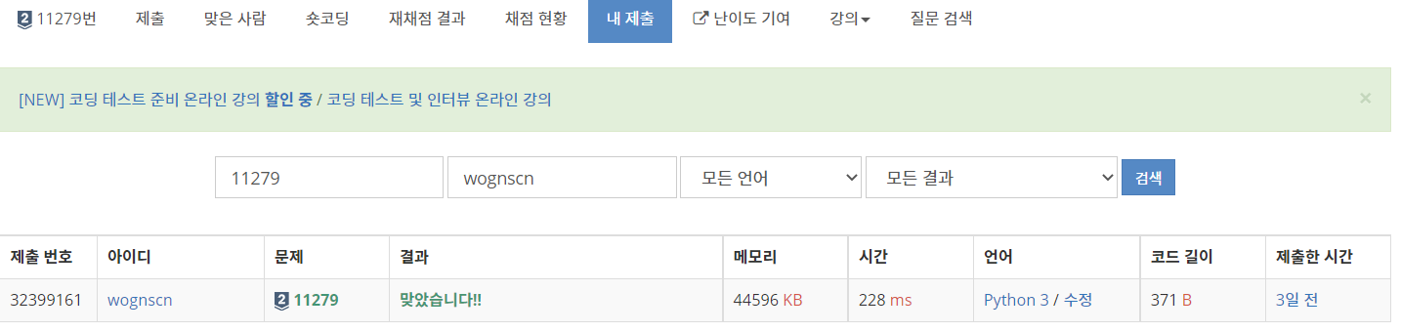
Result/Feedback

